Slide 1
Software Project Management
Lecture # 1

Slide 2
Course Objective
To learn the techniques required to plan, organize, monitor and control software development projects

Slide 3
Learning aspects in SPM …
Managing people, process and problems during a software project
Relating software metrics with software projects
Estimating effort, cost and project duration
Risk assessment techniques
Project scheduling
Project quality management
Change management during software development and after delivery to customer

Slide 4
Books
Text Book:
  Software Engineering: A Practitioner’s Approach 6/e or 7/e – by Roger Pressman
Reference Material:
  A Guide to The Project Management Body of Knowledge – PMI Standards Committee (William R. Duncan)
  Software Engineering Project Management – Edited by Richard H. Thayer (Original Contributions by numerous authors)
  Other relevant resources may be included

Slide 5
Course Contents
Topics from Roger Pressman’s Book
  Chapter 21 - Project Management
  Chapter 22 - Metrics for Process and Projects
  Chapter 23 - Estimation
  Chapter 24 - Project Scheduling
  Chapter 25 - Risk Management
  Chapter 26 - Quality Management (selected topics)
  Chapter 27 - Change Management
From reference material – contents in lecture slides and in the form of handouts

Slide 6
Course Website
http://web.uettaxila.edu.pk/CMS/AUT2010/seSPMbs/index.asp

Slide 7
LECTURE #1
The beginning…

Slide 8
Lecture Outline
Introduction
  Basic concepts
Project Management & Software Project Management
Project Management Skills
PMBOK

Slide 9
Introduction
Software Project Management

Slide 10
What is Software?
Software can be considered a product of engineering just like an airplane, automobile, television, or an other object that requires a high degree of skill to turn a raw material into a usable product.
But software is developed or engineered, not manufactured!

Slide 11
What is Software? (Contd.)
Software can be of different types:
  System software
  Application software
  Engg./Scientific software
  Embedded software
  Product-line software
  Web-applications
  Artificial Intelligence software
  etc.
Notes:
System software
Drivers, operating system components, compilers, editors, etc.
Application software
Stand-alone software for specific business need, transaction processing system
Scientific software
Stress analysis software, simulation software
Embedded software
Reside within a product or system, keypad control for microwave, dashboard display, digital systems for auto fuel control.
Product-line software
Word-processing, spread sheets, database management
Artificial Intelligence software
Game playing, expert systems

Slide 12
What is a Project ?
PMI* definition
  It is a temporary endeavor (having specific start and completion dates) undertaken to create a unique product or service
* Project Management Institute

Slide 13
What is a Project ? (Elaboration)
Temporary
  It means that every project has a definite beginning and definite end
    End is reached when project’s objectives have been achieved OR it is clear that objective will not be met. The project is terminated in such a situation
  The term temporary does not apply to a project’s product or service (which is a lasting result)
Unique
  It means that the product or service is different in some distinguishing way from all similar products or services

Slide 14
What is a Project ? (Contd.)
Projects may involve a single person or thousands
Projects may be completed in hours, several months or years
Examples of projects
  Developing a new product or service
  Designing a new vehicle
  Constructing a building
  Running a campaign for political office
  Implementing a new business procedure or process
  And so on …

Slide 15
What is Management?
It is a set of activities and tasks undertaken by one or more persons for the purpose of planning & controlling the activities of others in order to achieve an objective or complete an activity that could not be achieved by others acting independently.
Koontz, H., C. O’Donnell and H. Weihirch, Management, 7th ed., McGraw-Hill, New York,N. Y., 1980

Slide 16
What is Management? (Contd.)
Components of Management:
  Planning
  Organizing
  Staffing
  Directing (Leading)
  Controlling

Slide 17
What is Management? (Contd.)
Planning
  Pre-determining course of action to achieve the objectives
Organizing
  Establishing relationship among work units and granting responsibility and authority to obtain the objectives
Staffing
  Selecting and training people
Directing (Leading)
  Creating an atmosphere that will assist & motivate people to achieve the desired end results
Controlling
  Establishing, measuring, and evaluating performance of activities towards planned objectives

Slide 18
What is Project Management ?
It is the discipline of planning, organizing, and managing resources to bring about the successful completion of specific project goals and objectives

Slide 19
Project Management (Contd.)
Following are related to Project Management
  Professional Organizations
    Project Management Institute (PMI) (pmi.org)
    Software Engineering Institute (SEI)
    IEEE Software Engineering Group
  Certifications (offered by PMI)
    PMP (Project Management Professional)
    CAPM (Certified Associate in Project Management)
  PMBOK – Project Management Body of Knowledge, published by PMI
  Tools
    MS Project
    Primavera Project Manager

Slide 20
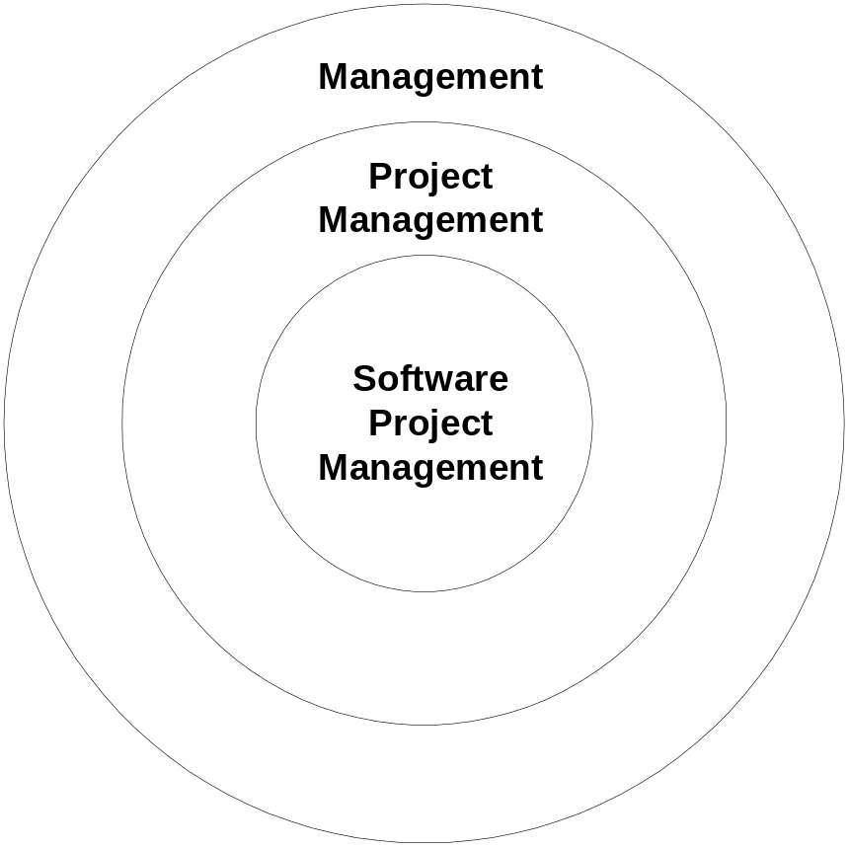
Software Project Management

Slide 21
Software Project Management
A sub-discipline of project management in which software projects are planned, monitored and controlled

Slide 22
Software Project Management (Contd.)
Software development is a complex undertaking particularly when it involves many people working over a relatively long time.
Hence software development projects need to be managed.
Everyone involved “manages” to some extent, but the scope of management activities varies for every person.

Slide 23
Managerial Skills
Robert L. Katz identified three kinds of skills for administrators*. The fourth may be added to it.
  Technical skills
  Human skills
  Conceptual skills
  Design skills
*in “Skills of an Effective Administration” 1955, and “Retrospective Commentary”, 1974, both printed in Harvard Business Review

Slide 24
Managerial Skills (Contd.)
Technical skills
  Knowledge of & proficiency in activities involving methods, processes & procedures.
  Working with tools & specific techniques.
Human skills
  Ability to work with people.
  Cooperative effort, team work.
  Creating a conducive environment for people/ workers.

Slide 25
Managerial Skills (Contd.)
Conceptual skills
  Ability to see the “big picture”.
  Ability to recognize significant elements in a situation & to understand the relationship among them.
Design skills
  Ability to solve problems that will eventually benefit the enterprise.
  The skill to design effective & practical solutions to problems rather than becoming “problem watcher” only.
  Important for upper level managers.

Slide 26
Skills Vs. Management Levels in Organizational Hierarchy
Conceptual & Design Skills
Top Management
Middle Management
Human Skills
Supervisors
Technical Skills

Slide 27
Project Management Skills
Project Management Skills (in simple words)
  Leadership
  Communications
  Problem Solving
  Negotiating
  Influencing the Organization
  Mentoring
  Process and technical expertise

Slide 28
PMBOK
The Project Management Body of Knowledge (PMBOK) is a collection of processes and knowledge areas generally accepted as best practice within the project management discipline.
Generally accepted means that it is applicable to most of the projects most of the time.
It is an internationally recognized standard (IEEE Std 1490-2003).

Slide 29
PMBOK (Contd.)
PMBOK recognizes 5 basic process groups and 9 knowledge areas typical of almost all projects.
The five basic process groups are:
  Initiating
  Planning
  Executing
  Monitoring and Controlling
  Closing

Slide 30
PMBOK (Contd.)
The nine suggested Knowledge Areas are:
  Project Integration Management
  Project Scope Management
  Project Time Management
  Project Cost Management
  Project Quality Management
  Project Human Resource Management
  Project Communications Management
  Project Risk Management
  Project Procurement Management

Slide 31
References
Today’s lecture has been taken from:
  Software Engineering: A Practitioner’s Approach – Roger Pressman
  Software Engineering Project Management – Richard H. Thayer
  PMBOK-2000.pdf

Slide 32
End of the Lecture!

